Slide 1
Measure chaos in the heart
Will An

Slide 2
Self Introduction
Name: Will An
From: Chaos Lab
Adviser: Dr. Flavio
Current research: Determine Chaos numerically

Slide 3
Structure of the talk
1. What is Chaos?
Logistic Map
Cardiac system
2. Lyapunov exponent
3. How do we get Lyapunov exp
4. Results from two methods
5. Future work

Slide 4
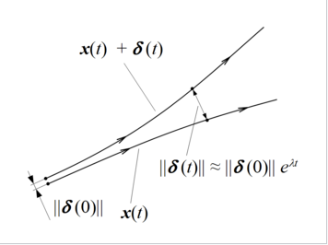
What is Chaos – Balls bouncing
Chaos, in this talk, I will address it as Butterfly effect.
A tiny initial change can result big difference
Demo of chaos
Balls bouncing: https://xiaodongan.cn/bouncing_cirlce_final_verlet.html

Slide 5
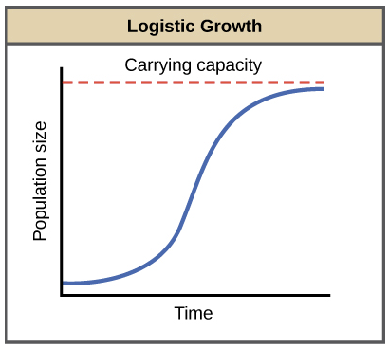
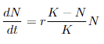
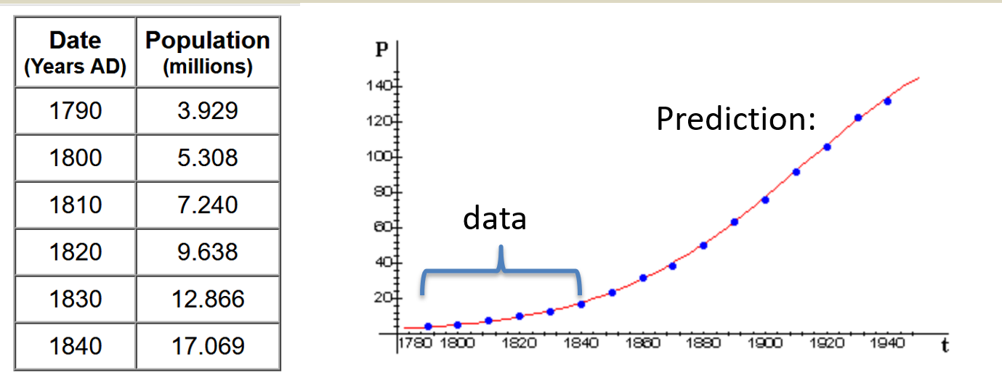
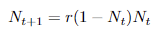
What is Chaos – Population growth
Let’s take Population growth as another example
Logistic growth:
N: population
T: time
r: per capita rate of increase
K: carrying capacity
Pierre Verhulst (1838) used this function to perfectly predict population growth in the US
Its simplified version: Logistic map

Slide 6
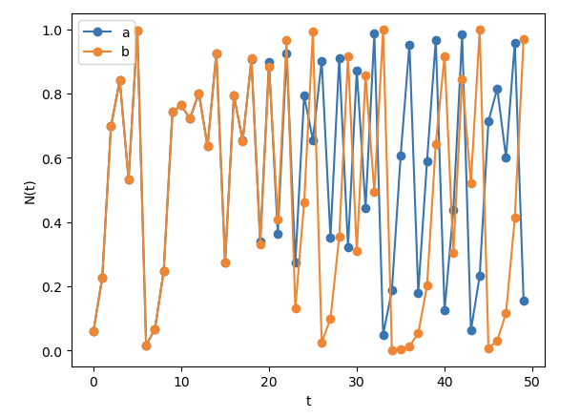
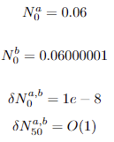
What is Chaos – Population growth
Let’s take Logistic Map as an example
The evolution function:
Let r = 4, and plot two trajectories a,b
And set their initial population N as follows:
After 50 iterations, their diff jump from O(1e-8) →O(1)
That’s exponential growth!
Initial diff
Final diff

Slide 7
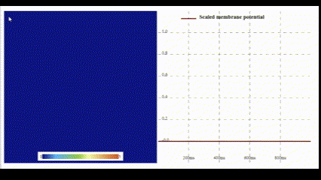
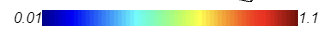
What is Chaos – Cardiac System
Real-time simulation heart in a 2D space.
GPU parallel speed up
Take the Fenton-Karma model (1998) model as an example:
(Or 3-Variable model, where 3V means Na +, Ca 2+, K +)

Slide 8
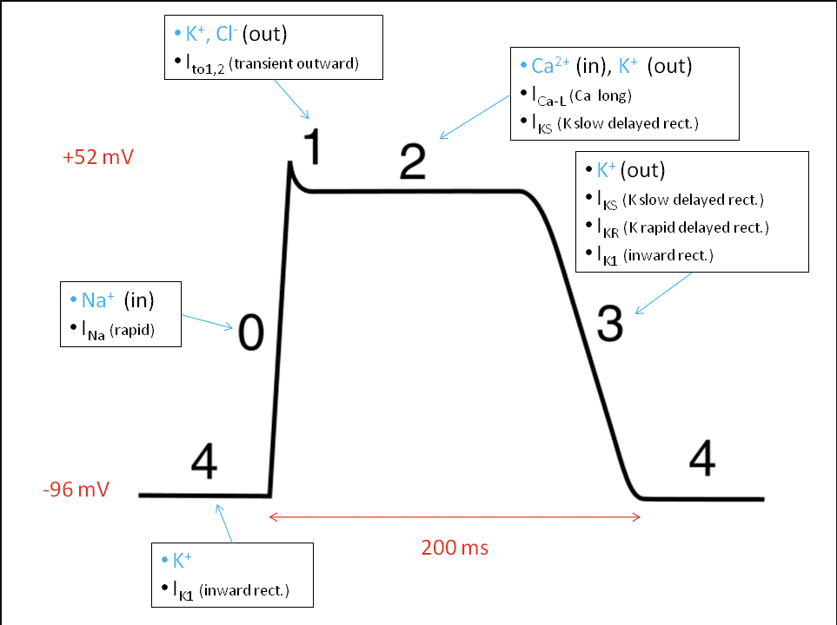
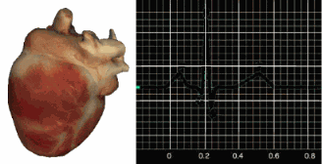
What is Chaos – Cardiac System
Once voltage reaches actional potential (say, 0)
Your cardiac muscle cell starts to contract
Heart will beat around once/second
And this is controlled by pacemaker cell
automatic action potential generation capability
Demo: https://kaboudian.github.io/CinC-2021-Competition/2D-3V-Minimal-Model/
Each cell generates an action potential (change in voltage)
Heart’s contraction is driven by an electrical wave

Slide 9
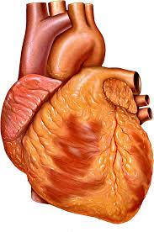
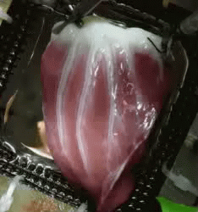
What is Chaos – Cardiac System
Real-time simulation heart in a 2D space.
GPU parallel speed up
Take the Fenton-Karma model (1998) model as an example:
(Or 3-Variable model, where 3V means Na +, Ca 2+, K +)
Wave propagating
(simulation)
Wave propagating (Experiment, pig ventricle)
Voltage

Slide 10
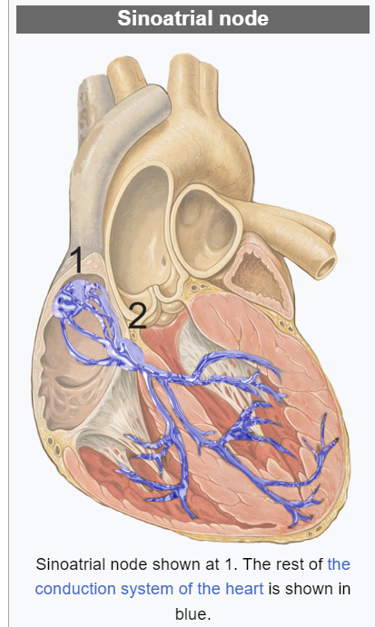
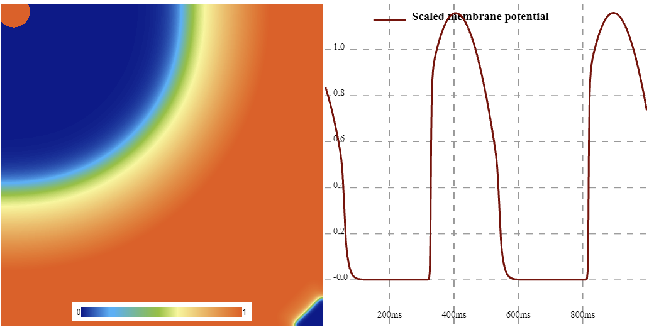
What is Chaos – Cardiac System
(right atrial)
The pacemaker cells are at position 1
In the simulation, it is from where you click (make v = 1).

Slide 11
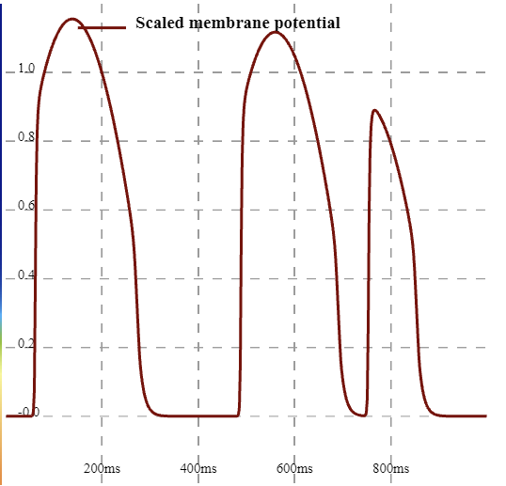
What is Chaos – Cardiac System
Now if we click faster, a lower beat will show.
This means heart cell does not rest enough so the ion cannot exchange well to get normal peak voltage
This might cause Irregular heartbeat (arrhythmia), even chaos
That is why we want Chaos detection here.

Slide 12
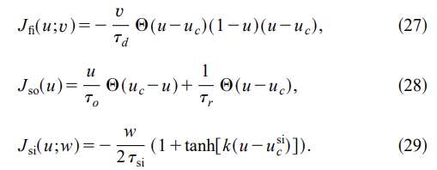
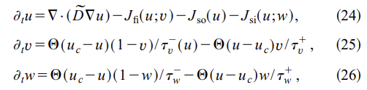
What is Chaos – Cardiac System
It is a simplified model to simulate human heart muscle.
3V: Na +, Ca 2+, K +
It can approximate spiral wave behavior of more complex human heart models
So basically, solving less equations, but getting approximately realistic heart simulation.
Na+ current
K+ current
Ca+ current

Slide 13
What is Chaos – Cardiac System
It is a simplified model to simulate human heart muscle.
u: cell membrane voltage
v, w: inactivation–reactivation gate for channels
Tau: time constant
Na+ current
K+ current
Ca+ current

Slide 14
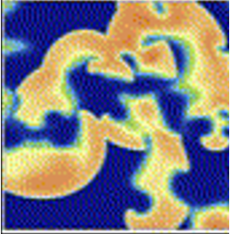
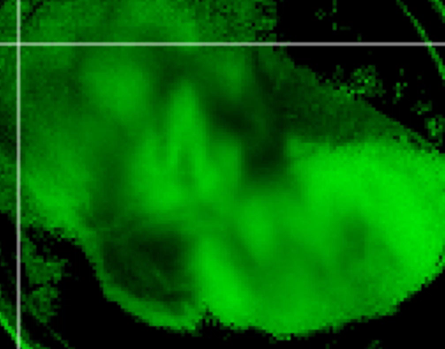
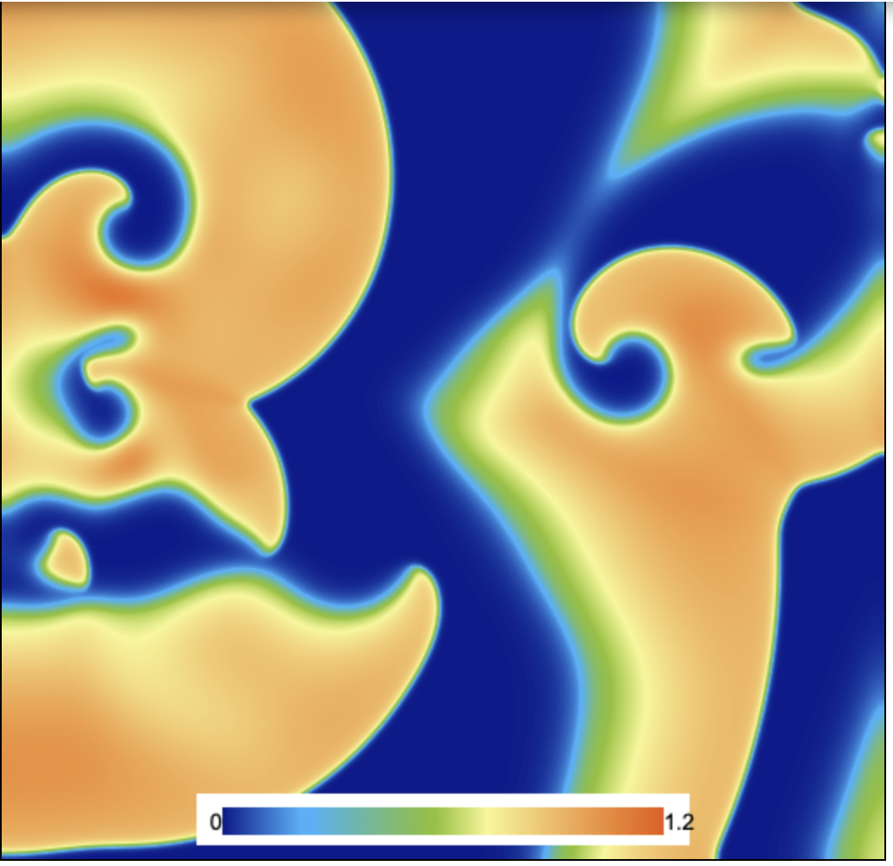
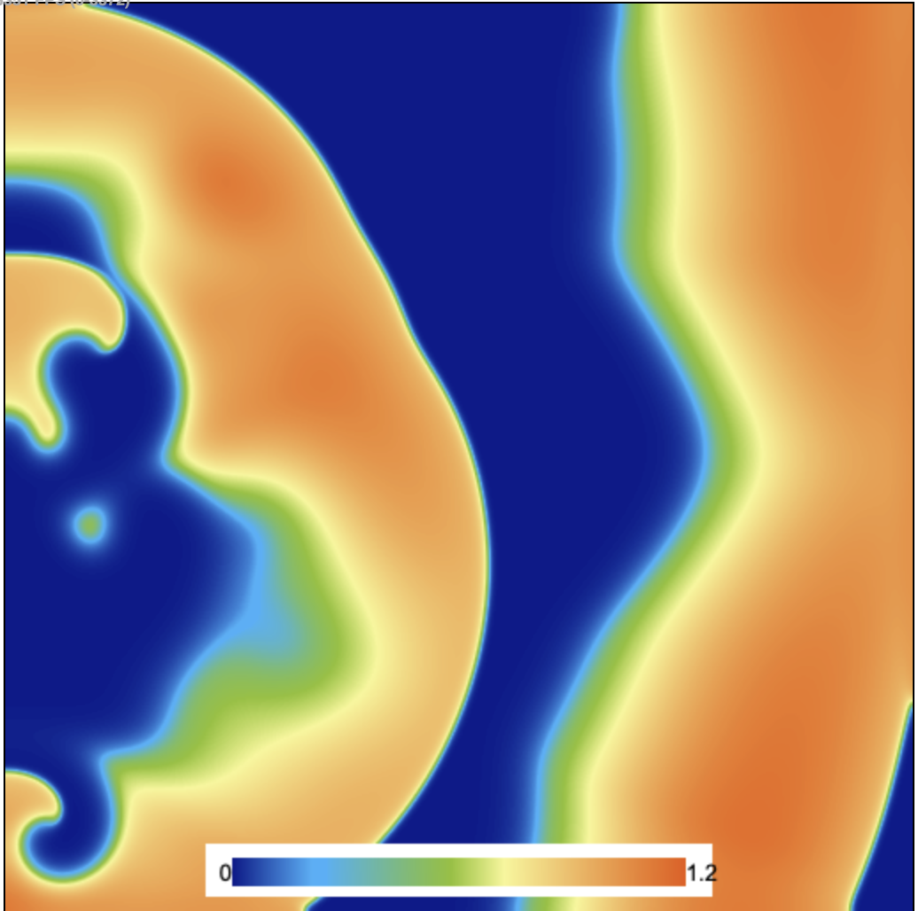
What is Chaos – Cardiac System
Now let’s create some irregular heartbeat (arrhythmia)
You can simply do it by randomly drag on map
Here, to make comparison, I start the arrhythmia by coding to make each simulation having same initial condition
We run simulations twice with tiny change on tau_d:
tau_d1 = 0.407, tau_d2 = 0.405
https://xiaodongan.cn/2D-3V-Model-copy/index.html
It turns out they show completely different frame after 20000 iterations.
VF Experimental Human Ventricle
tau_d1 = 0.407
tau_d1 = 0.405

Slide 15
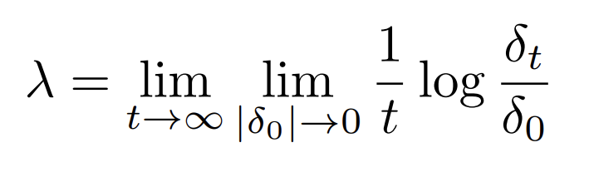
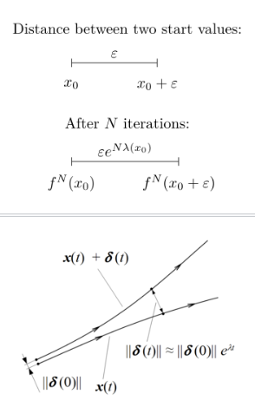
Lyapunov Exp – How do we quantify chaos
Lyapunov exponent of a dynamical system is to characterizes the rate of separation of infinitesimally close trajectories.
Formula for LE
λ > 0: chaotic system
δ(t)>>δ(0) (difference has exp growth)
λ = 0: periodic
δ(t)=δ(0) (difference has no growth)
λ < 0: stable (convergent to fix point)
Usually, we use the maximal Lyapunov exponent (MLE)
Which is the maximum possible LE you could get during iterations.
This means chaos

Slide 16
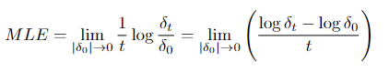
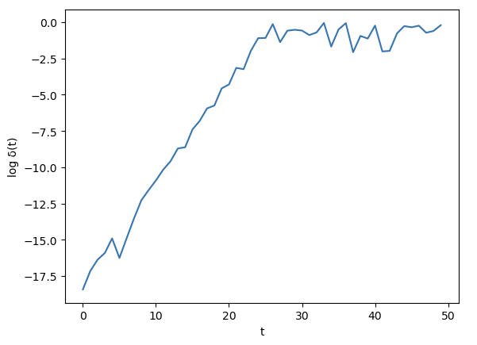
Lyapunov Exp – How do we quantify chaos
So largest slope you could get
t needs to be large enough to be valid

Slide 17
Lyapunov Exp – How do we quantify chaos
Let’s try this on logistic map:
λ = slope ~ 1 > 0
λ > 0: chaotic system
λ = 0: periodic
λ < 0: stable (convergent to fix point)
It’s shown to be chaotic.

Slide 18
Lyapunov Exp – How do we quantify chaos
Formula for LE
What about 2D cardiac system?
We know the initial difference = Δtau_d = 0.02
But what about the final difference?
We do not have two clear trajectories to compare.
So, here introduce Temporal method and Spatial method

Slide 19
How do we get Lyapunov exp - Temporal
Temporal method: Nonlinear Time Series Analysis (TISEAN)
It can calculate LE (Lyapunov Exp) for any scalar temporal data:
For example: A list that stores a sequence of voltage from a cell
L = [V1,V2,…,Vt]

Slide 20
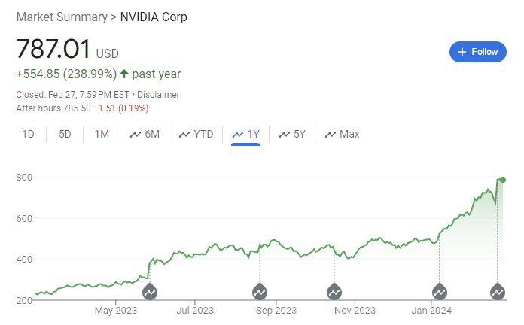
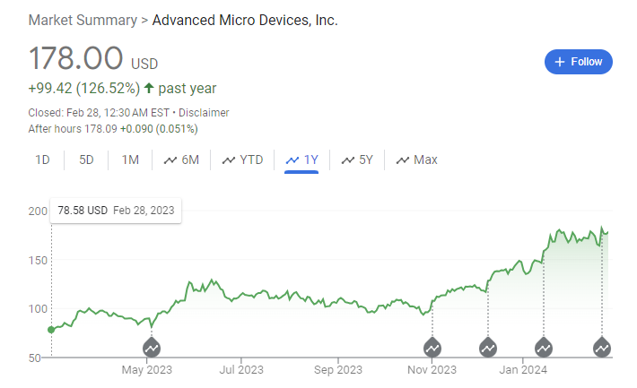
How do we get Lyapunov exp - Temporal
Temporal method: Nonlinear Time Series Analysis (TISEAN)
It can calculate LE for scalar temporal data:
A higher LE means harder to predict, can make/lose big money
LE = λ = 0.2
Harder to predict!
LE = λ = 0.15

Slide 21
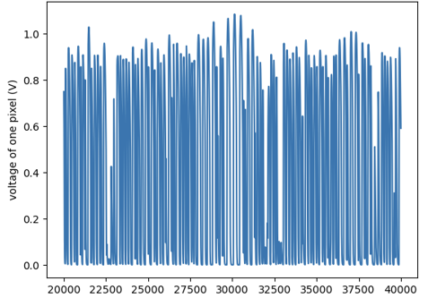
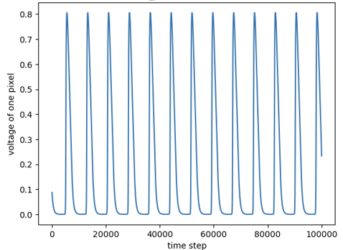
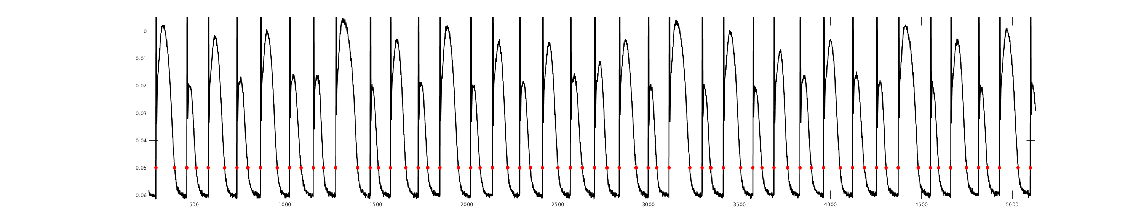
How do we get Lyapunov exp - Temporal
Temporal method: Nonlinear Time Series Analysis (TISEAN)
It can calculate LE for scalar temporal data:
LE = λ = 0.33
LE = λ = -0.01
Example of experimental signal during chaos from fish heart

Slide 22
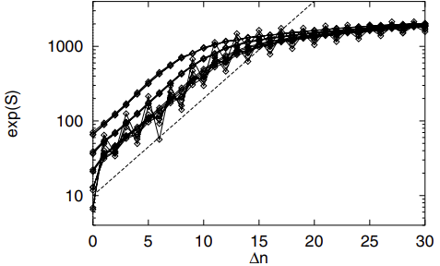
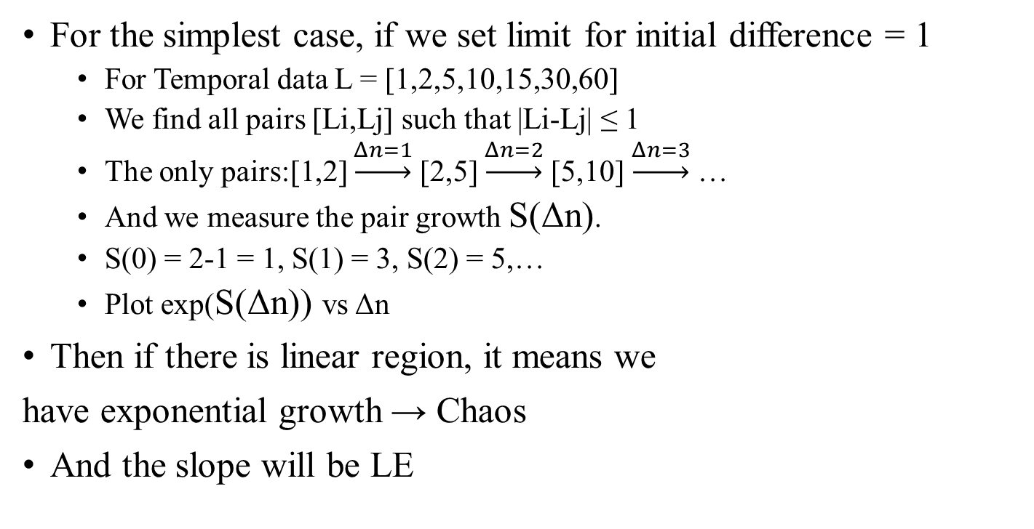
How do we get Lyapunov exp - Temporal
For the simplest case, if we set limit for initial difference = 1
For Temporal data L = [1,2,5,10,15,30,60]
We find all pairs [Li,Lj] such that |Li-Lj| ≤ 1
The only pairs:[1,2] $\underset{→}{Δn=1}$ [2,5] $\underset{→}{Δn=2}$ [5,10] $\underset{→}{Δn=3}$ …
And we measure the pair growth S(Δn).
S(0) = 2-1 = 1, S(1) = 3, S(2) = 5,…
Plot exp(S(Δn)) vs Δn
Then if there is linear region, it means we
have exponential growth → Chaos
And the slope will be LE

Slide 23
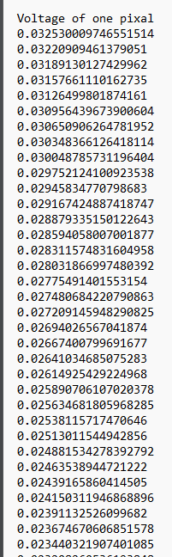
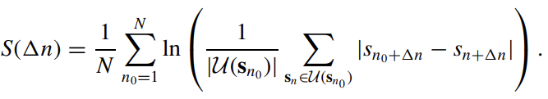
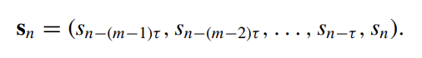
How do we get Lyapunov exp - Temporal
Sn0
m = 3
τ = 4
time
Method called Tisean (Nonlinear Time Series Analysis)
sn is the time series data (like voltage vs time)
Sn is the embedded vector
τ is delay
m is embedded dimension
U(s) is the neighbor numbers of Sn0 (vector distance smaller than ε)
N is the total reference vectors (SnN) we consider
Sn1
Neighbor of Sn0 if |vector diff| < ε

Slide 24
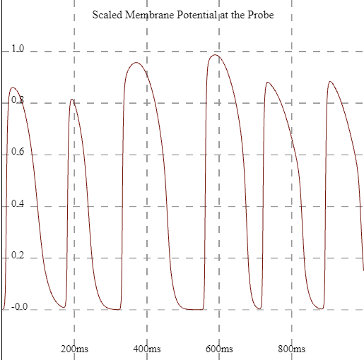
How do we get Lyapunov exp - Temporal
Now we can determine chaos simply from a temporal series data.
But what about the 2D cardiac map or a real heart?
We can measure its voltage vs time in one pixel (one cell), and the apply TISEAN

Slide 25
How do we get Lyapunov exp - Spatial
Drawback for TISEAN or : both need long time series to get slope,
So, can we utilize the spatial information to decrease time length?
And bring us more spatially Chaos knowledge about the system.
So, now it comes Spatial method

Slide 26
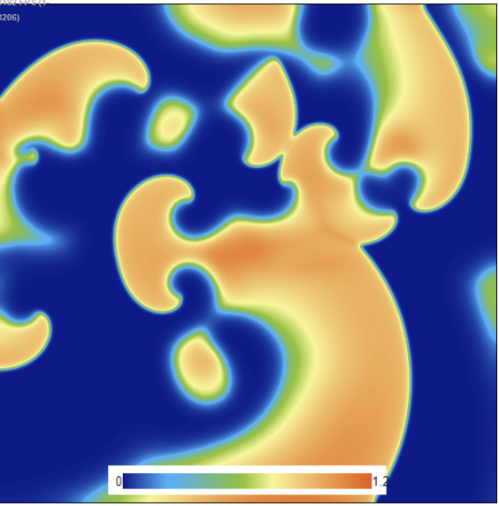
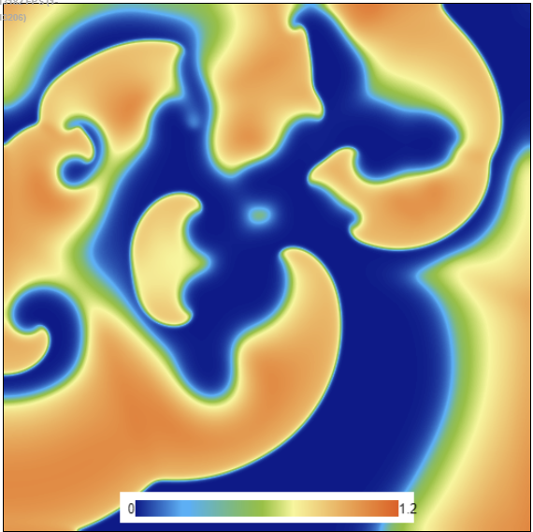
How do we get Lyapunov exp - Spatial
For the simplest case, spatiotemporal LE is defined:
For all pixels/points in a map, we find similar pairs <k,h>
And evolve them d steps
Then check whether the pairs have exponential growth
k
k
Duration d
h
→ → → →
h
At time 0
At time 0+d

Slide 27
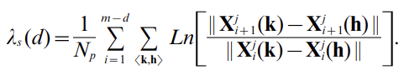
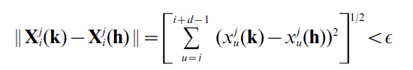
How do we get Lyapunov exp - Spatial
A new spatiotemporal LE is defined:
s means spatial
k = every point of 2D map from t_i to t_(i+d)
h = neighboring points of k from t_i to t_(i+d) (neighbor distance < a small value)
d = embedded dimension
N_p = number of <k, h> pairs (take average)
j = type of X variable
i = time step

Slide 28
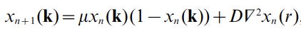
How do we get Lyapunov exp - Spatial
Coupled map lattices (CML) is used to prove this method
Every point in CML is just like logistic map, but also affected by its neighboring (Laplacian):
Now, in this 2D lattice map, it runs twice, first time recording one point with long time (200 steps)
Second time recording all points in lattice, with a short time

Slide 29
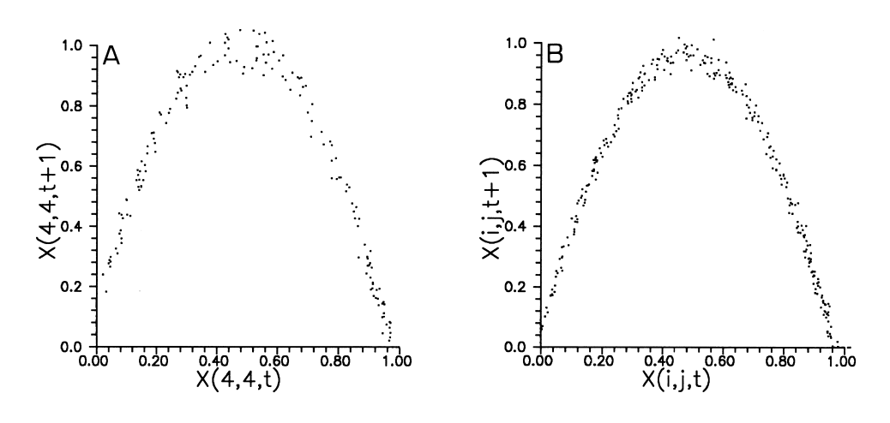
How do we get Lyapunov exp - Spatial
First time one point with long time; Second time all points with a short time
First, one point only
Second, all points
t = [0,200]
t = [0,10]

Slide 30
How do we get Lyapunov exp - Spatial
Now we see that they are very similar.
The lack of temporal information is compensated by the spatial information
It works in Logistic map.
First, one point only
Second, all points
t = [0,200]
t = [0,10]

Slide 31
Results – determine heart chaos
We can regard chaos/arrythmias in cardiac system as an inability for heart cells to restore their normal states.
For example, a smaller/irregular beat is formed by pacing too fast so that cells cannot restore itself
Tau_d controls the magnitude of Na current
Na+ current
K+ current
Ca+ current

Slide 32
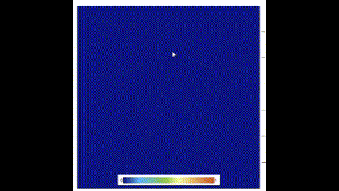
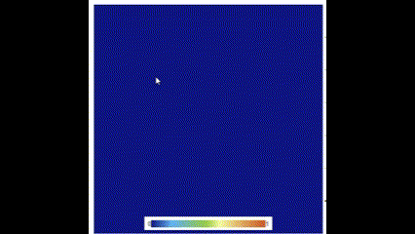
Results – determine heart chaos
We select tau_d = [0.395 – 0.42] which is the region for Persistent Fibrillation: heart beats in an irregular pattern and often beats faster than usual. It cannot get back to its regular rhythm on its own
Fibrillation → regular pattern
Persistent Fibrillation

Slide 33
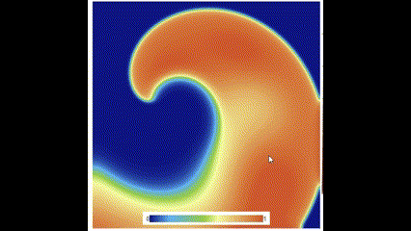
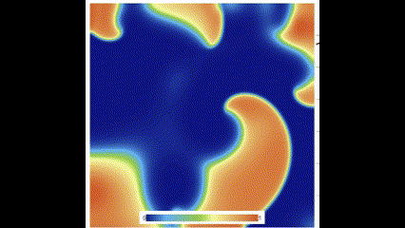
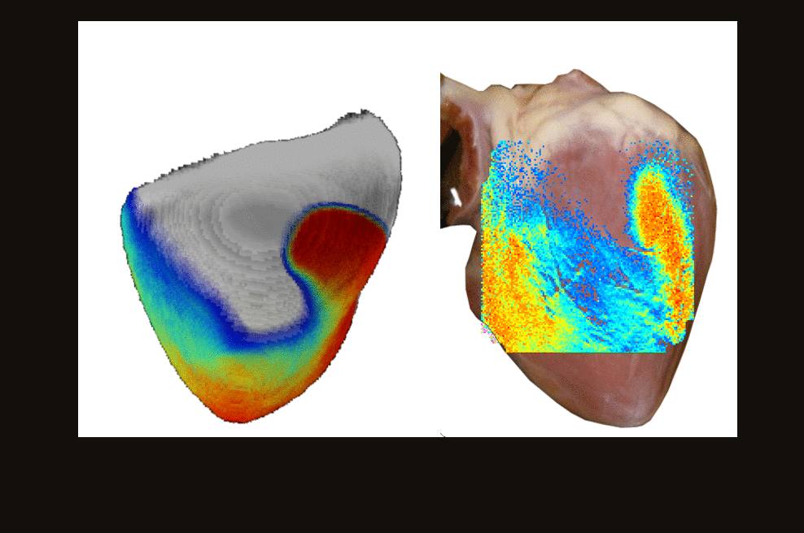
Results – determine heart chaos
One spiral wave = Tachycardia
Muliple spiral waves = fibrillation
Tau_d = 0.42
Tau_d = 0.407

Slide 34
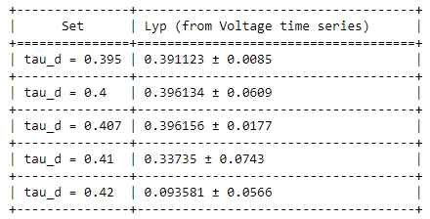
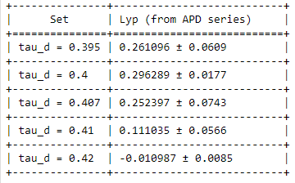

Results – determine heart chaos (temporal)
APD
tau_d from slopes
Tau_d = 0.42
Tau_d = 0.407

Slide 35

Results – determine heart chaos (temporal)
APD
For tau_d < 0.395, tau_d > 0.42, no Persistent fibrillation → stable, and λ = -∞
For tau_d > 0.41 → periodic
For 0.395< tau_d < 0.41 → chaotic
lyp(APD) < lyp(V):
APD only considers duration between activated voltage
Two different beats might have same APD
So APD lose some information for chaos
λ > 0: chaotic system
λ = 0: periodic
λ < 0: stable (convergent to fix point)

Slide 36

Results – determine heart chaos (spatial)
This method only applies to APD, since Voltage requires long time series input to reflect chaos
For spatial one, it is more sensitive to chaos (its period LE is much smaller)
Both methods can distinguish between chaotic and periodic.

Slide 37





Results – determine heart chaos (spatial)
Recurrence plot

Slide 38
Conclusion
Both temporal and spatial methods can be used on determining heart chaos.
Spatial method (APD) is more sensitive to chaos
Temporal method (APD) will lose some chaotic information but still work

Slide 39

Future work
In the future, more parameters can be considered
In the experiment, we could apply spatial LE on finding abnormal heart region.
Like what ECG does, abnormal heart region will show spatially local chaos

